Slide 1


Xamarin and .NET Build Automation
Allan Pead - @adpead
Xamarin Insider, Xamarin Premier Consultant Partner (AD Software Systems)

Slide 2
What is Continuous Integration?
A development practice where developers share code changes many times a day. This is usually to a single source repository.
These changes are “continuously integrated” with other team members code.
Continuous delivery is a software engineering approach in which teams produce software in short cycles, ensuring that the software can be reliably released at any time. It aims at building, testing, and releasing software faster and more frequently.

Slide 3
Why Continuous Integration?
Helps prevent “IT WORKS ON MY PC!”
Fix problems sooner rather than later
Reduce risk by reducing the time inbetween integration of
code changes with others
Produce code instead of fix complex integration problems
Visibility improves communication between distributed teams

Slide 4
How?
Continuous Integration Server monitors source repository and checks out the code to a local work area
The code is automatically built
Unit tests and / or integration tests are run
The fully tested build is deployed for further testing
Teams informed (eg email)

Slide 5
MS Build / xbuild
Microsoft’s build engine, used primarily for .NET applications.
Xbuild is Mono’s build engine (Phased out in favour of OSS MS Build)
ACCELERATE

Slide 6
MS Build Fundamentals
Properties
Set of configuration items
Items
List of defined items (Mostly files)
Target
Task or set of tasks
Import Targets
Reference another MS Build File
ACCELERATE

Slide 7
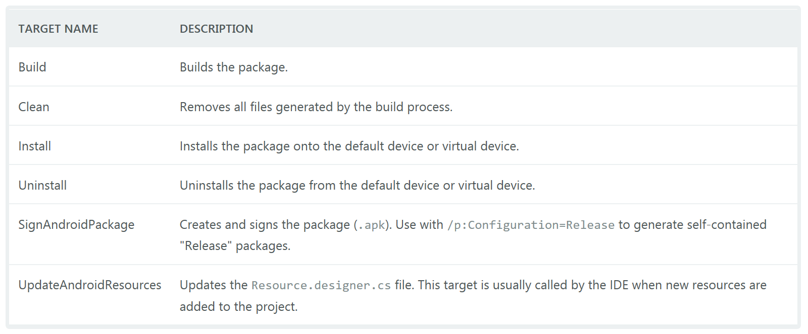
Xamarin and MS Build
ACCELERATE

Slide 8
More on MSBuild
MSDN
https://msdn.microsoft.com/en-us/library/dd393573.aspx
MS Build Community Tasks
https://github.com/loresoft/msbuildtasks
ACCELERATE

Slide 9
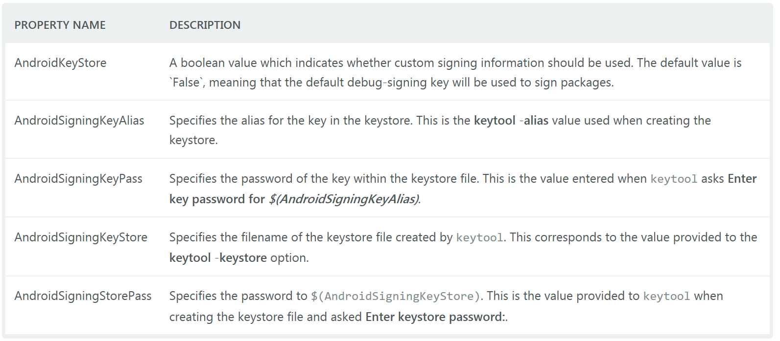
Android - Packaging
ACCELERATE

Slide 10
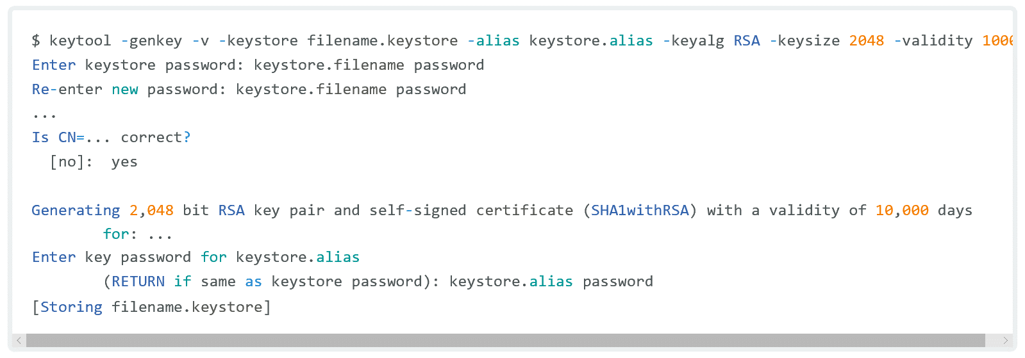
Android - Packaging
ACCELERATE

Slide 11
Android - Packaging
Jarsigner
The jarsigner command uses key and certificate information from a keystore to generate digital signatures for JAR files. A keystore is a database of private keys and their associated X.509 certificate chains that authenticate the corresponding public keys. The keytool command is used to create and administer keystores.
Zipalign
zipalign is an archive alignment tool that provides important optimization to Android application (APK) files. The purpose is to ensure that all uncompressed data starts with a particular alignment relative to the start of the file. Specifically, it causes all uncompressed data within the APK, such as images or raw files, to be aligned on 4-byte boundaries. This allows all portions to be accessed directly with mmap() even if they contain binary data with alignment restrictions. The benefit is a reduction in the amount of RAM consumed when running the application.
ACCELERATE

Slide 12
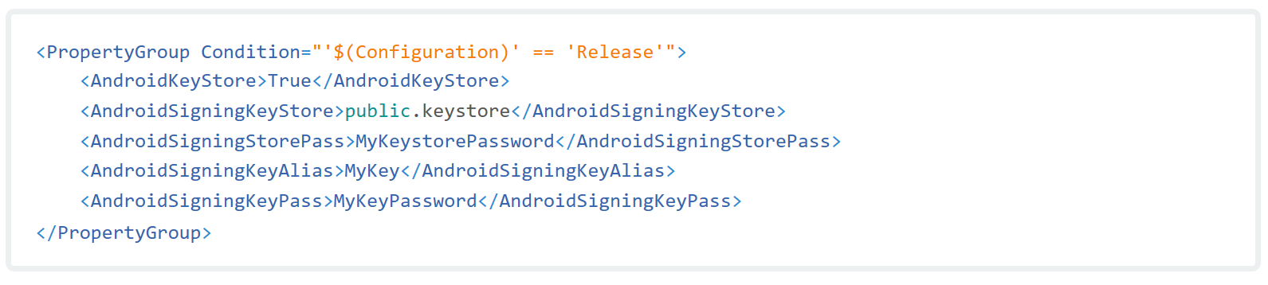
Android - Packaging
ACCELERATE

Slide 13
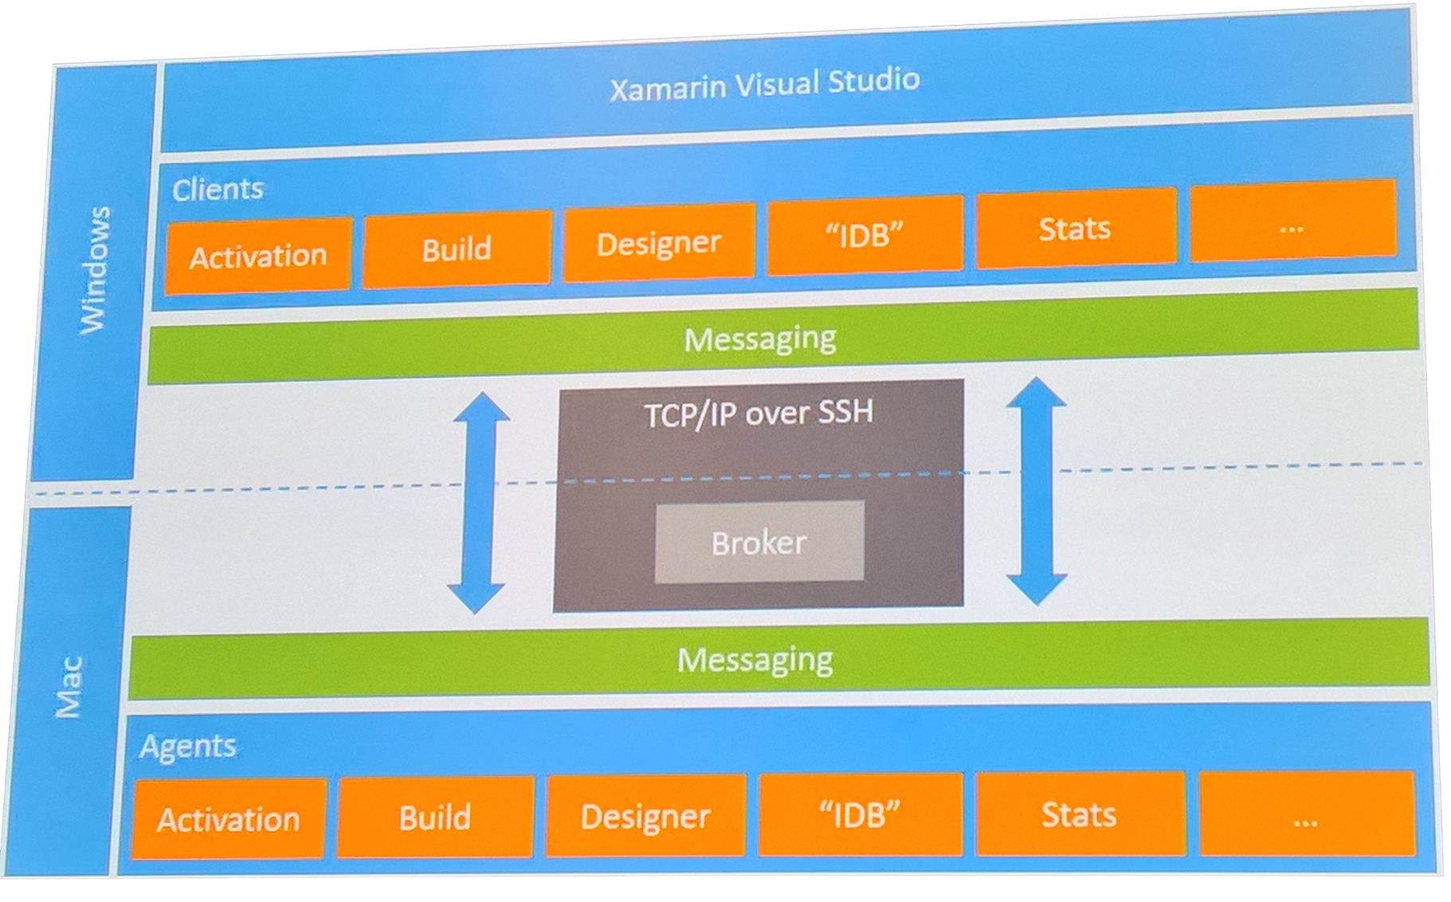
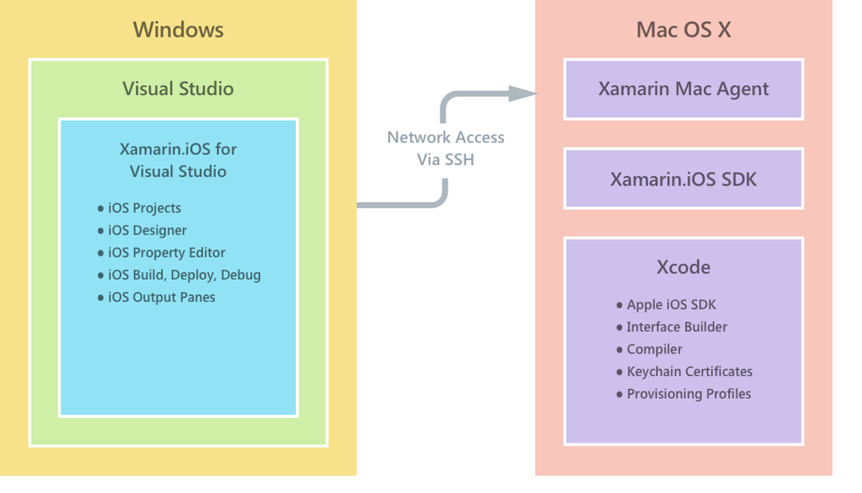
iOS Build Agent
ACCELERATE

Slide 14
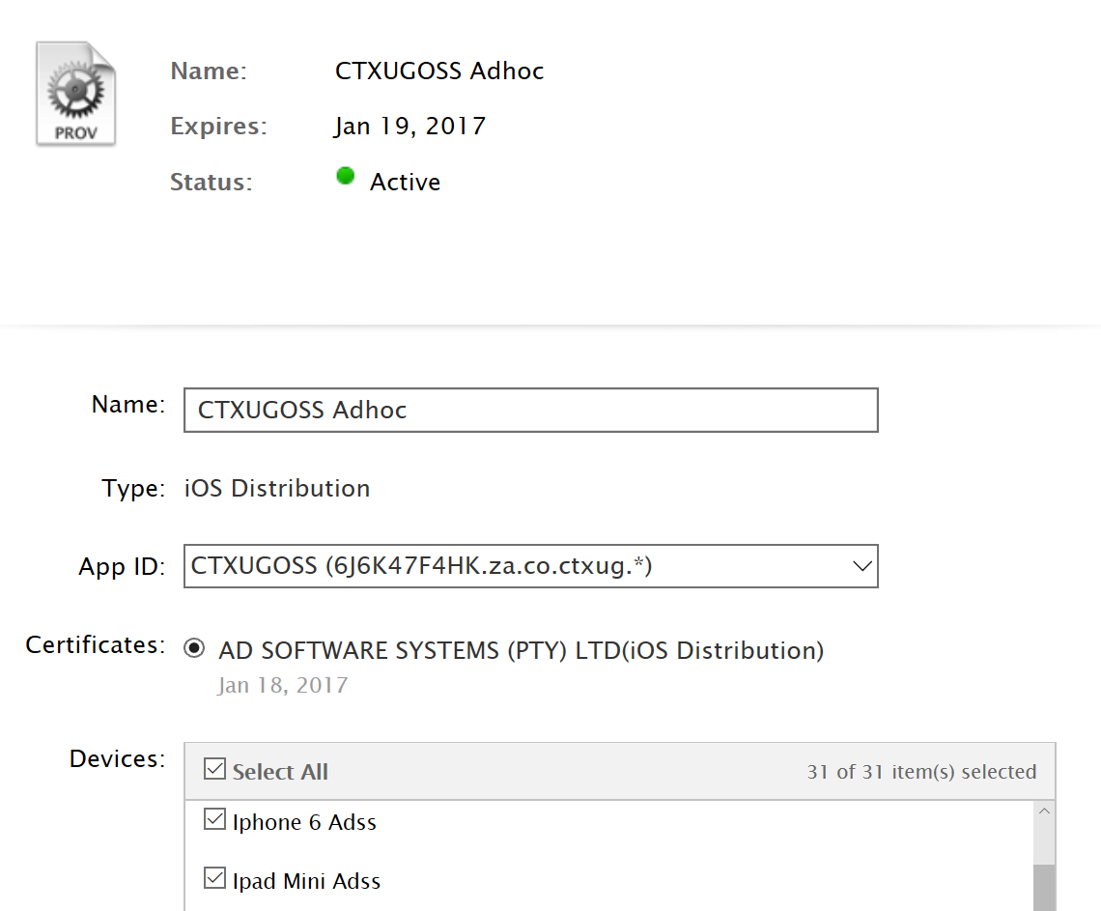
iOS - Packaging
ACCELERATE

Slide 15
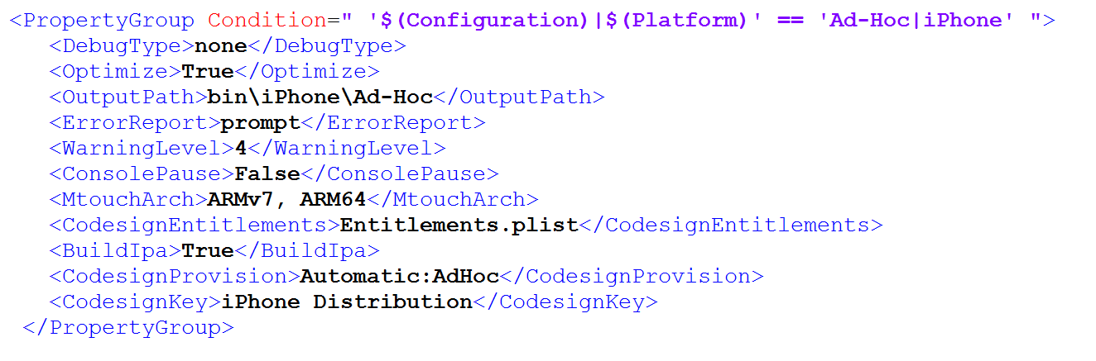
iOS - Packaging
ACCELERATE

Slide 16
Continuous Integration Tools
Jenkins
https://developer.xamarin.com/guides/cross-platform/ci/jenkins_walkthrough/
Team City
https://developer.xamarin.com/guides/cross-platform/ci/teamcity/
TFS
https://developer.xamarin.com/guides/cross-platform/ci/tfs_walkthrough/
ACCELERATE

Slide 17
Jenkins Demo

Slide 18
Visual Studio Team Services Demo

Slide 19
Visual Studio Mobile Center Demo

Slide 20
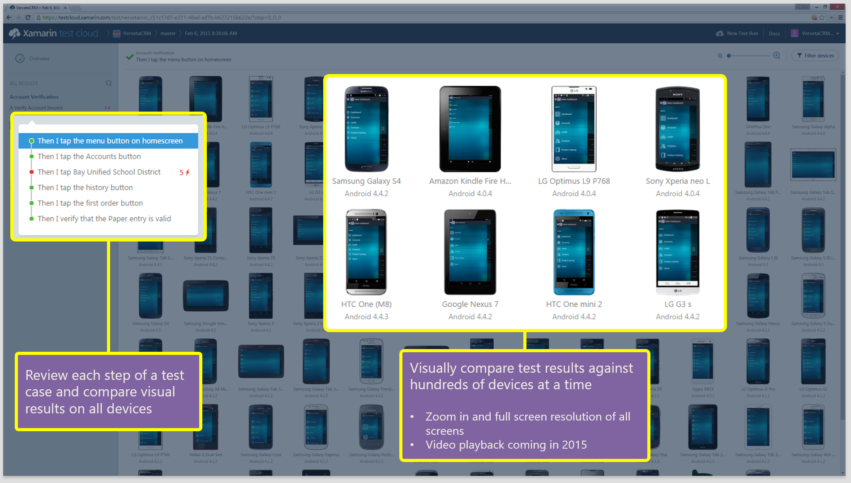
Test Cloud Dashboard
ACCELERATE

Slide 21
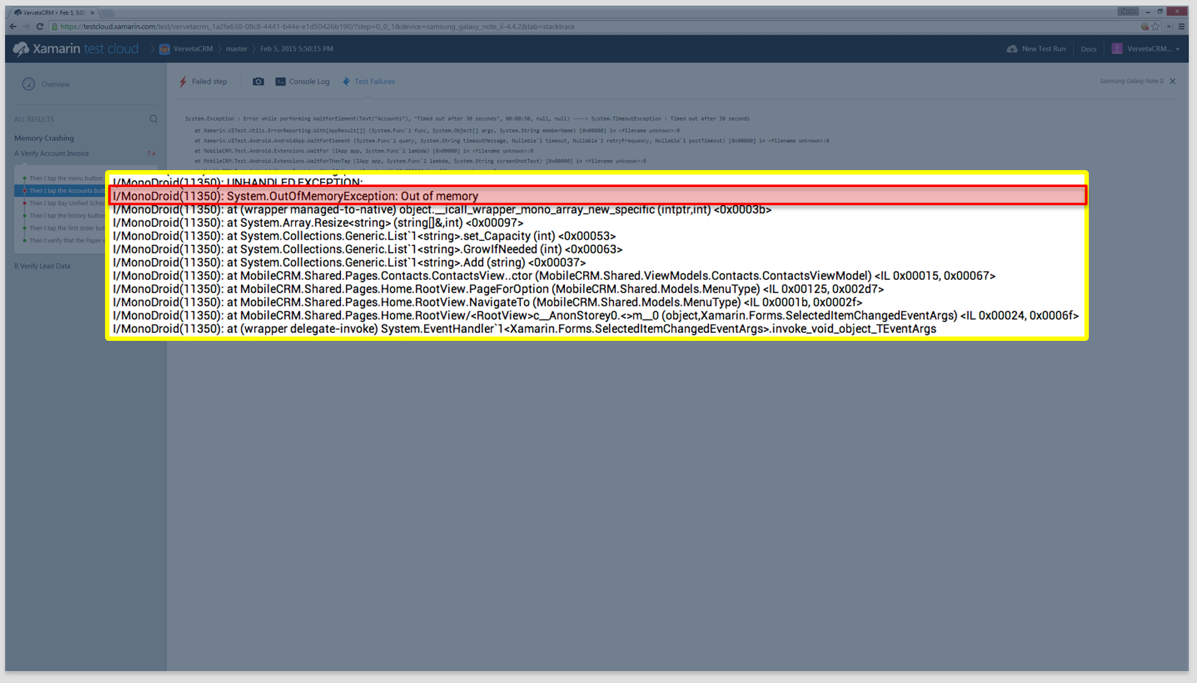
Test Cloud Dashboard
ACCELERATE

Slide 22
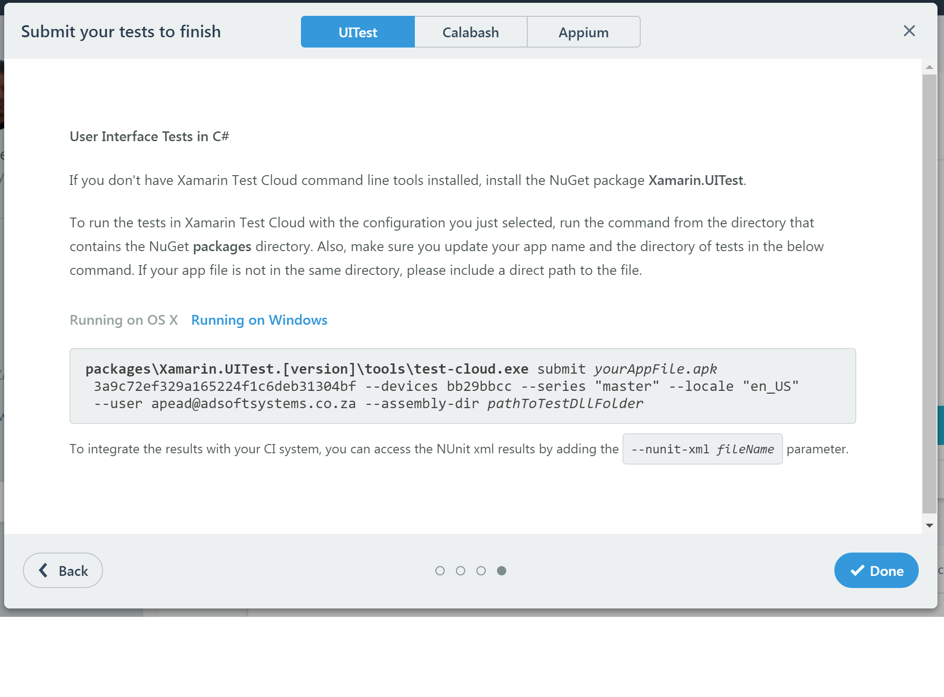
Supported Testing Frameworks
https://developer.xamarin.com/guides/testcloud/uitest/

Slide 23
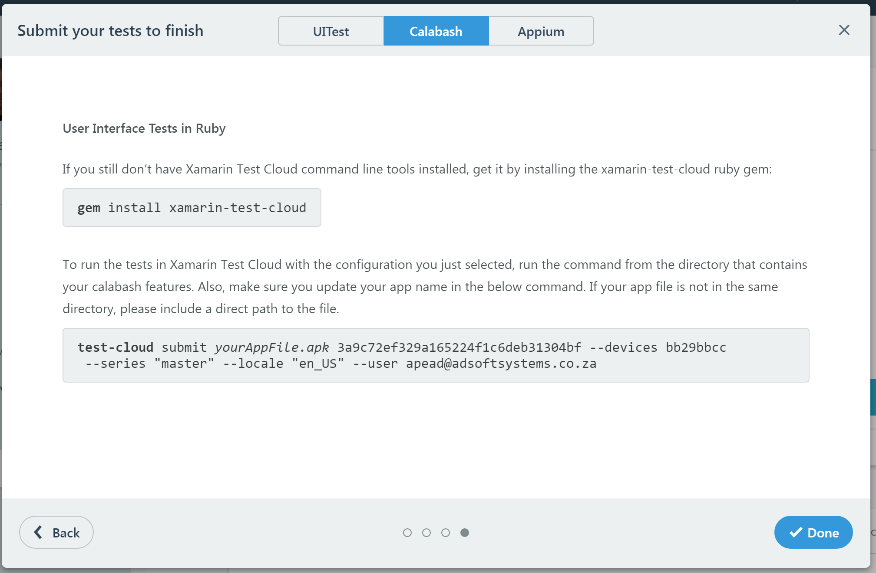
Supported Testing Frameworks
http://calaba.sh/

Slide 24
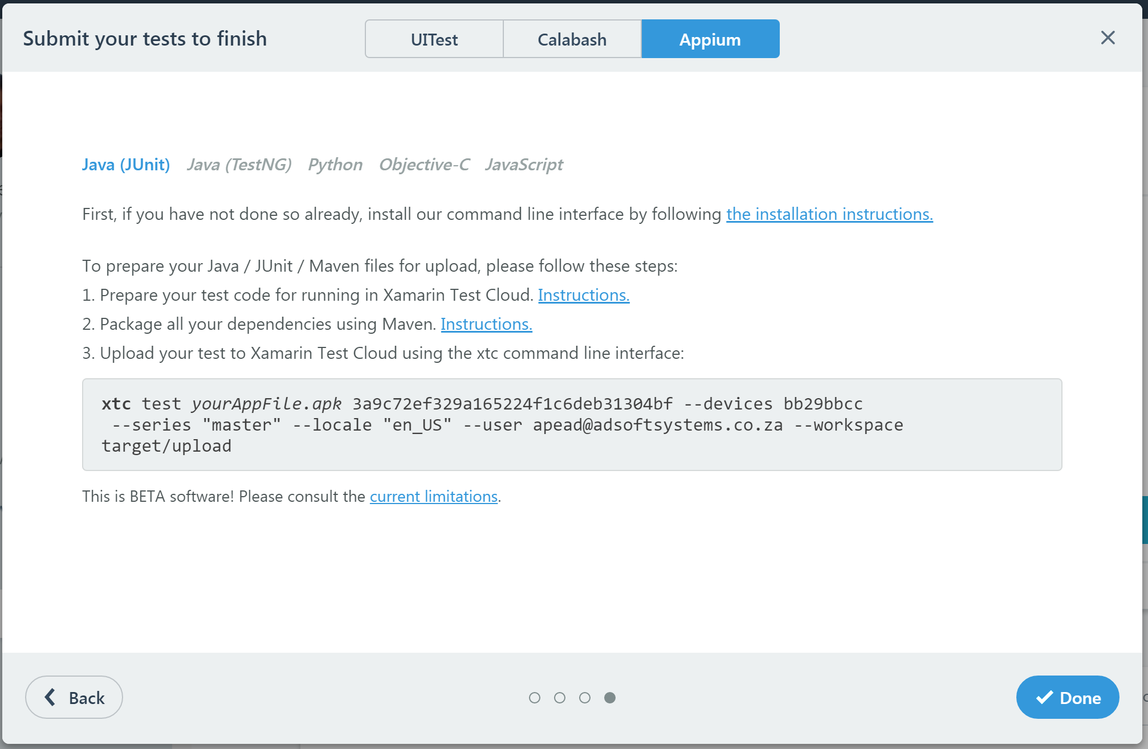
Supported Testing Frameworks
http://appium.io/

Slide 25
Xamarin Test Cloud Demo

Slide 26
Thank you!
Allan Pead - @adpead
Xamarin Insider, Xamarin Premier Consultant Partner (AD Software Systems)

